Slide 1


Slide 2


Why is this project important?
1. Helps doctors and therapists track patients and their treatment history.
2. Supports patients in receiving proper treatment based on their condition.
3. Useful for researchers to study mental health trends and associated factors.
4. Provides accurate statistics for governments or organizations to make data-driven decisions.

Slide 3

How can we benefit from a project like this?
Understand different types of mental health disorders.
Analyze the relationship between factors like age, gender, social conditions, etc., and mental health status.
Develop intelligent support systems using AI in the future.
Make booking and therapy follow-ups easier and more accessible online.

Slide 4

What kind of data should be included in the database?
1.Patients Table
2.Mental Health Conditions Table
3.Sessions Table
4.Therapists Table
5.Medications Table

Slide 5

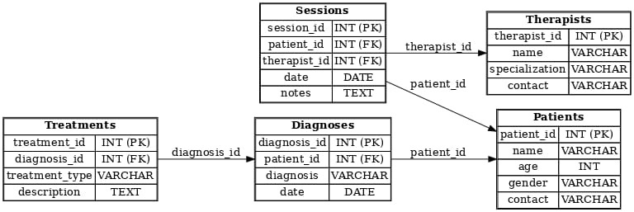
SCHEMA

Slide 6

contact VARCHAR(100)
);
CREATE TABLE Sessions (
session_id INT PRIMARY KEY,
patient_id INT,
therapist_id INT,
date DATE,
notes TEXT,
FOREIGN KEY (patient_id) REFERENCES Patients(patient_id),
FOREIGN KEY (therapist_id) REFERENCES Therapists(therapist_id)
);
CREATE TABLE Diagnoses (
diagnosis_id INT PRIMARY KEY,
patient_id INT,
diagnosis VARCHAR(200),
date DATE,
FOREIGN KEY (patient_id) REFERENCES Patients(patient_id)
);
CREATE TABLE Treatments (
treatment_id INT PRIMARY KEY,
diagnosis_id INT,
treatment_type VARCHAR(100),
description TEXT,
FOREIGN KEY (diagnosis_id) REFERENCES Diagnoses(diagnosis_id)
);
CODING
Create database mental_health;
CREATE TABLE Patients (
patient_id INT PRIMARY KEY,
name VARCHAR(100),
age INT,
gender VARCHAR(10),
contact VARCHAR(100)
);
CREATE TABLE Therapists (
therapist_id INT PRIMARY KEY,
name VARCHAR(100),
specialization VARCHAR(100),
);
CREATE TABLE Sessions (
session_id INT PRIMARY KEY,
patient_id INT,
therapist_id INT,
date DATE,
notes TEXT,
FOREIGN KEY (patient_id) REFERENCES Patients(patient_id),
FOREIGN KEY (therapist_id) REFERENCES Therapists(therapist_id)
);
CREATE TABLE Diagnoses (
diagnosis_id INT PRIMARY KEY,
patient_id INT,
diagnosis VARCHAR(200),
date DATE,
FOREIGN KEY (patient_id) REFERENCES Patients(patient_id)
);
CREATE TABLE Treatments (
treatment_id INT PRIMARY KEY,
diagnosis_id INT,
treatment_type VARCHAR(100),
description TEXT,
FOREIGN KEY (diagnosis_id) REFERENCES Diagnoses(diagnosis_id)
);

Slide 7
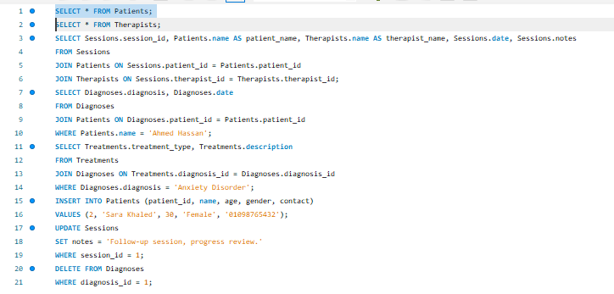
QURIES

Slide 8
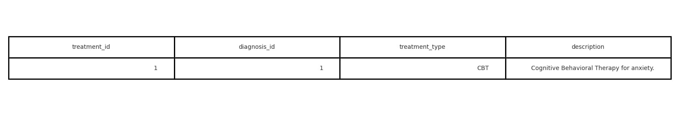
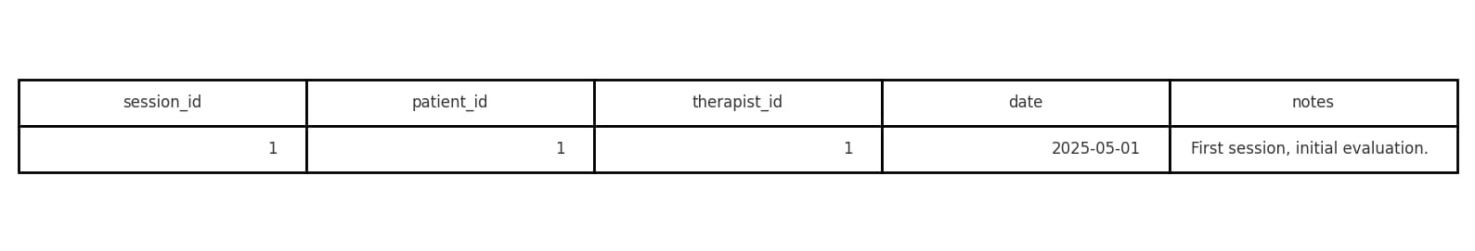
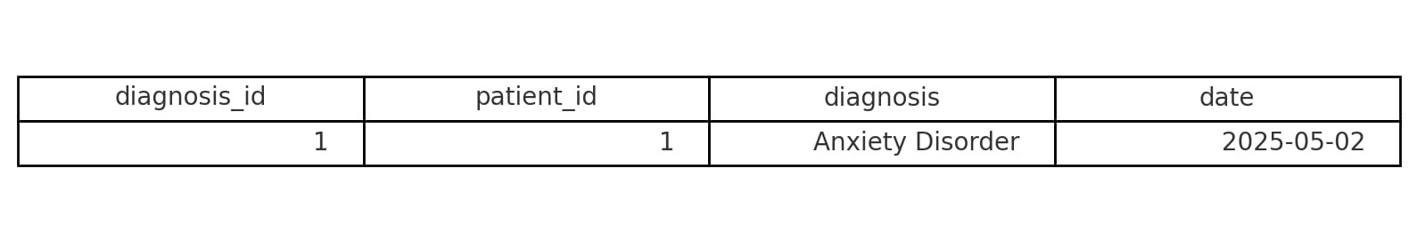
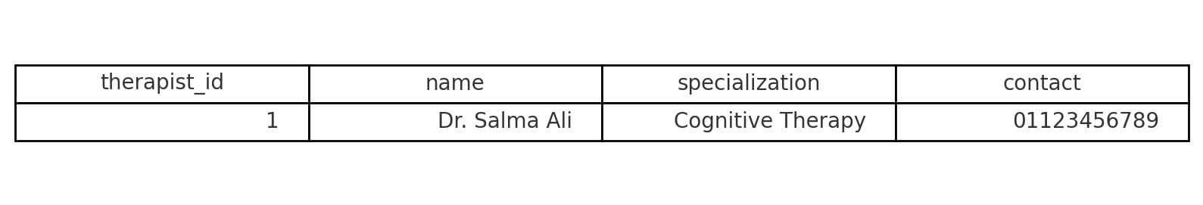
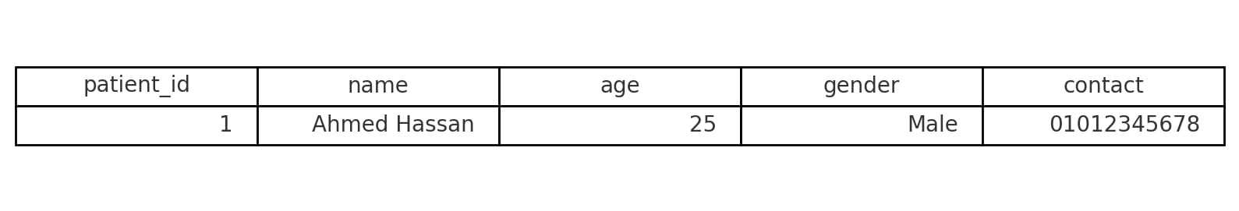
Tables

Slide 9


Thank you
MLSA
By : Ahmed .M. S

